Slide 1


DSS Applications
Dr. Parthasarathi Pattnayak

Slide 2
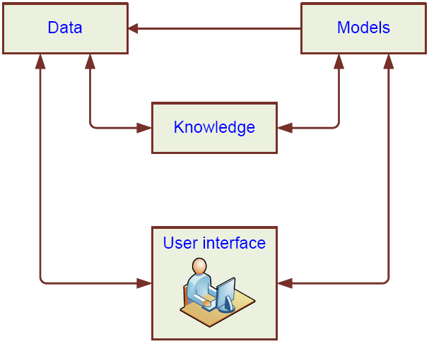
DSS Configurations
Each component
  has several variations; are typically deployed online
  Managed by a commercial of custom software
Typical types:
  Model-oriented DSS
  Data-oriented DSS

Slide 3
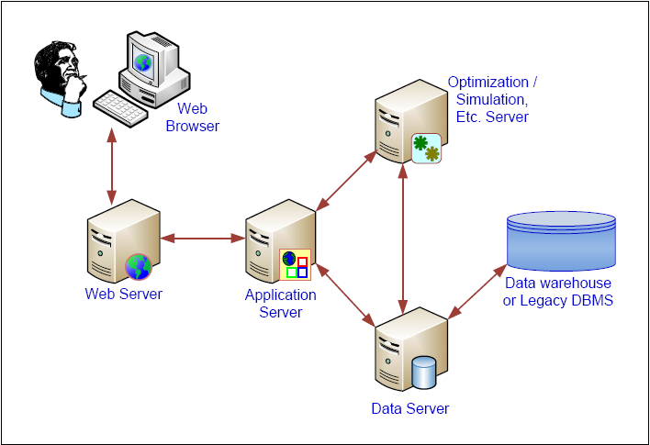
A Web-Based DSS Architecture

Slide 4
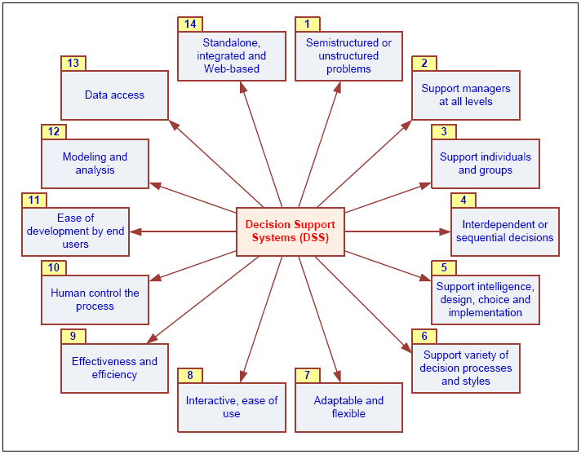
DSS Characteristics and Capabilities

Slide 5
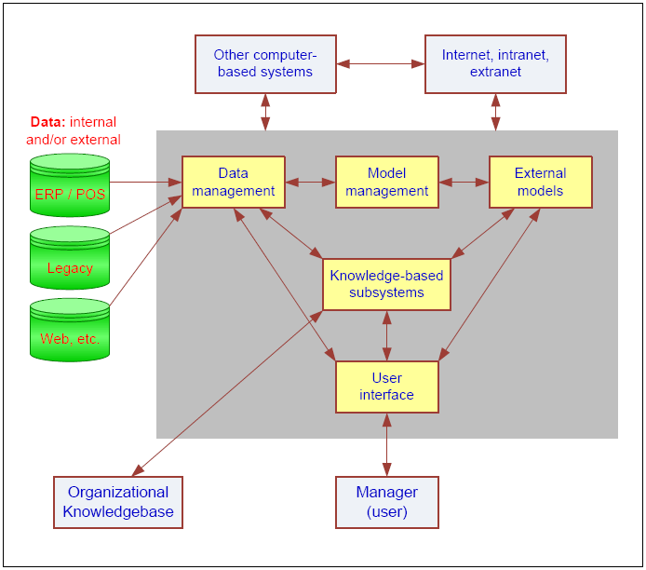
Components of DSS

Slide 6
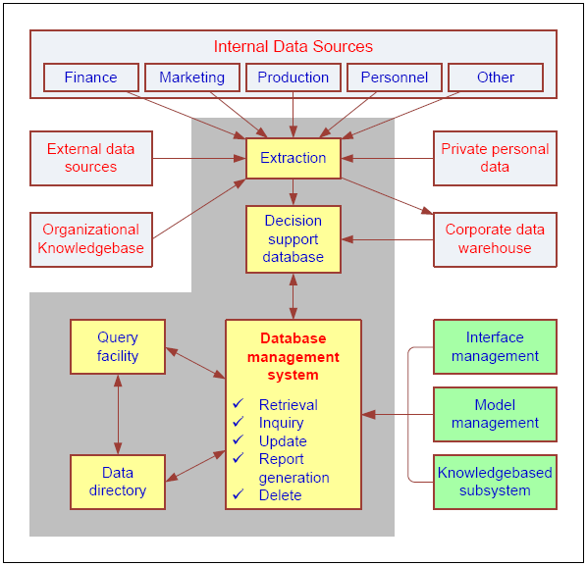
DSS Components
Data Management Subsystem
DSS database
DBMS
Data directory
Query facility

Slide 7
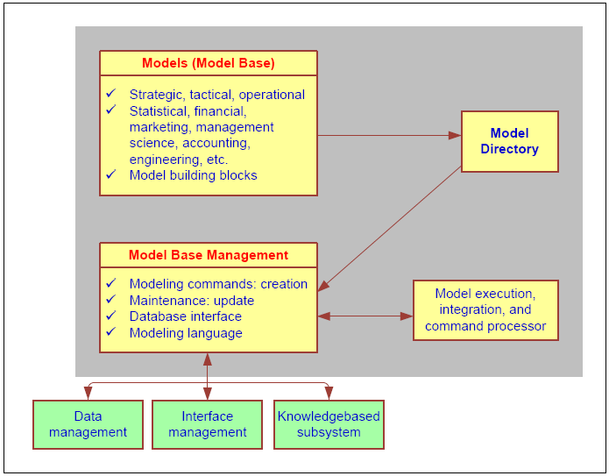
DSS Components
Model Management Subsystem
Model base
MBMS
Modeling language
Model directory
Model execution, integration, and command processor

